Slide 1



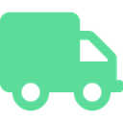

DISTRIBUTED WEB SERVICES PROJECT
Donor
FoodRescue TN
Driver
From surplus to someone's table.
Association
A microservices platform that connects donors, associations, drivers and citizens to fight food waste in Tunisia.
Environmental Protection in Tunisia
Malek Hammami
Donation Offer
Service
Mohamed Lotfi Sherif
Matching & Pickup service
Salma Boubakri
Partner Registry &Trust Service
Yasmine Ben Abdelkader
Impact Analytics Service
Mohamed Fadhel
Surprise Basket Marketplace Service
Rayen Ghileb
Volunteer Driver Service
Notes:
Team of 6. Theme: Environmental Protection in Tunisia.

Slide 2
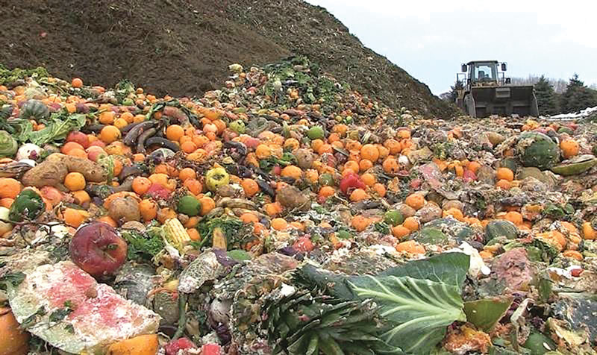
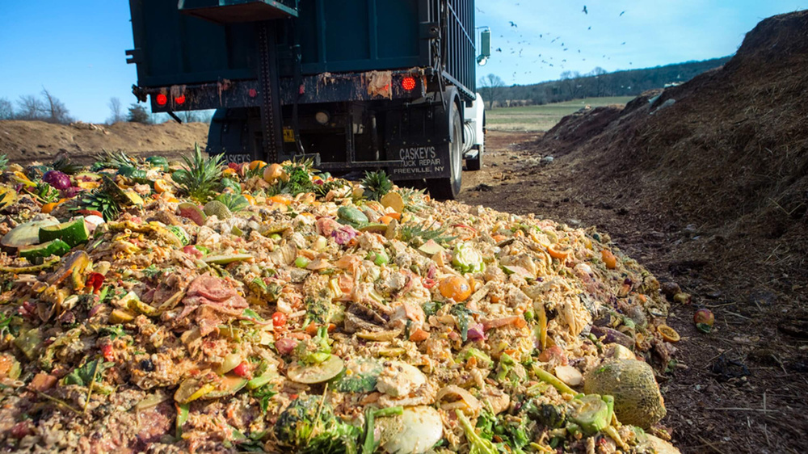
The Environmental Problem Addressed
In Tunisia, UNEP’s 2024 Food Waste Index estimates that each person wastes about 172 kg of food a year, nearly two million tonnes nationwide, mostly bread, cereals and vegetables. The impact goes beyond the food itself. Wasted food accounts for 8-10% of global greenhouse gas emissions, and food rotting in landfills releases methane, a gas that traps far more heat than CO₂. FoodRescue TN redirects edible surplus from bakeries, restaurants, hotels and shops to people who need it, before it becomes waste.
Identity
Donations
Impact
FoodRescue TN · 2
Notes:
Team of 6. Theme: Environmental Protection in Tunisia.

Slide 3
3 · The environmental problem and why it matters
WHY IT MATTERs: WORLDWIDE
IN TUNISIA
8–10%
of global greenhouse gas emissions come from food loss and waste
172 kg
of food wasted per person, every year
1.05 bn t
of food wasted in 2022: 19% of the food available to consumers
≈ 2 million tonnes nationwide
Most wasted: bread, cereals, vegetables
Rotting food releases methane. FoodRescue TN redirects edible surplus first.
Sources: UNEP, Food Waste Index Report 2024 (Tunisia and global figures); UNEP, "Food loss and waste", citing IPCC 2019 (8–10% of GHG emissions). 8–10% and 1.05 bn t are global figures.
FoodRescue TN · 3
Notes:
Team of 6. Theme: Environmental Protection in Tunisia.

Slide 4
Table of contents
01
The idea and the problem
Microservices Breakdown
02
Actors and main features
10
Donation Offer Service
03
General use case
11
Matching & Pickup Service
04
Architecture and security
12
Partner Registry & Trust Service
05
Microservices, responsibilities, databases
13
Impact Analytics Service
06
Communication between services
14
Volunteer Driver Service
07
Technologies and task allocation
15
Surprise Basket Marketplace Service
08
Git organisation and schedule
16
User & Auth + Notification
09
Main risks and mitigation
17
Functional and non-functional requirements
FoodRescue TN · 4

Slide 5
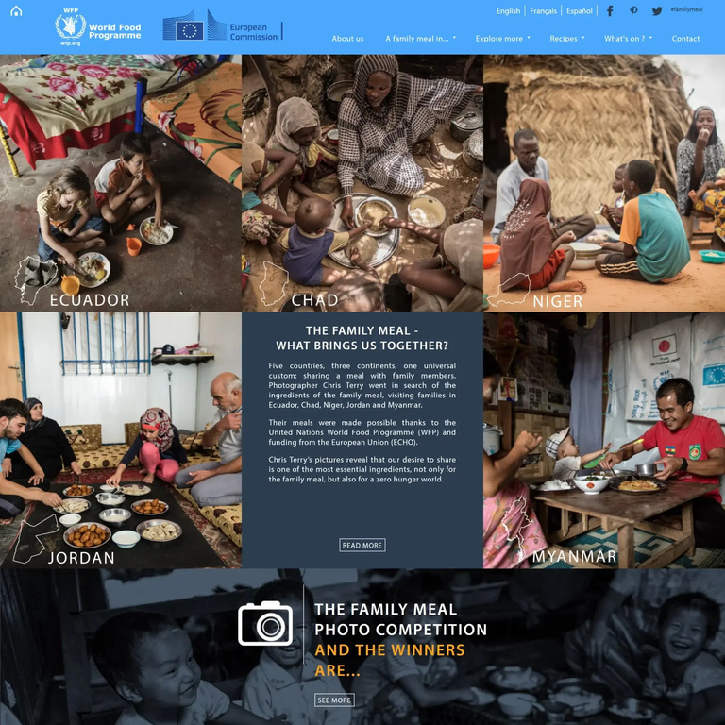
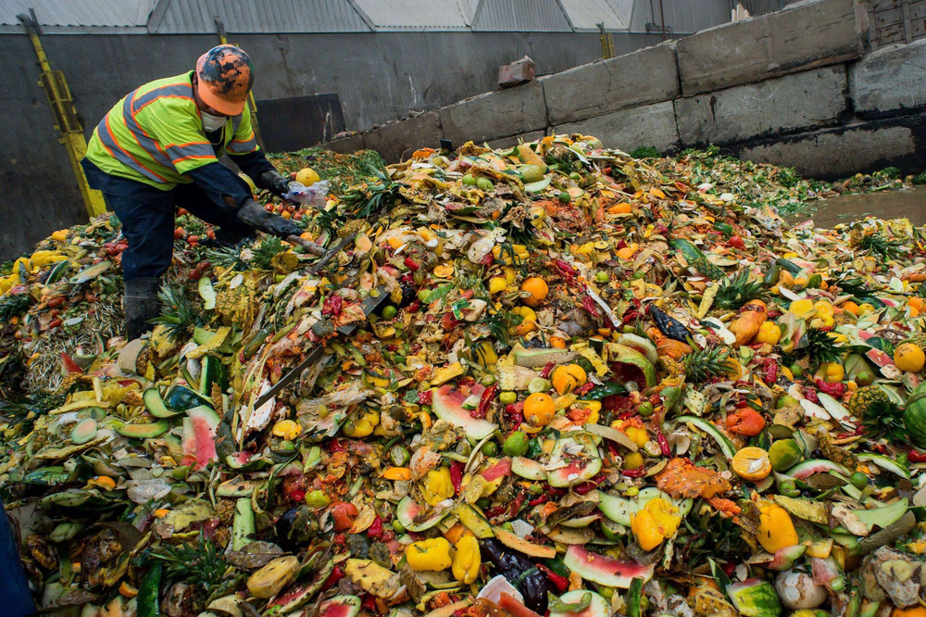
1 · The idea and the problem
The problem
The hidden cost
Restaurants, hotels, bakeries and supermarkets throw away edible surplus every day, while many families struggle to afford meals.
Every wasted meal also wastes the water, energy and CO₂ used to produce it.
Our idea
Our promise
FoodRescue TN lets businesses publish surplus, consumers reserve and collect meals, and charities receive donations, while admins moderate and impact is tracked. It is designed to be secure, scalable, resilient, observable, usable and maintainable.
Rescue surplus, share value and measure impact: FoodRescue TN turns unsold food into affordable meals and donations, and shows the environmental gains.
FoodRescue TN · 5

Slide 6
2 · Actors And Main Features
Donor 🥖
Citizen 🛒
Association/Charity 🤝
Volunteer Driver 🚗
Admin 🛡️
Bakery, restaurant, hotel or shop that publishes surplus food and provides pickup details.
Can purchase discounted “surprise baskets” made from available surplus food.
Receives donated food and coordinates its collection and distribution to people in need.
Picks up surplus food from donors and delivers it to associations.
Manages and monitors the platform, users, partners and overall activity.
MAIN FEATURES
Publish surplus
Type, quantity, pickup window, photo
Smart matching
Nearest compatible association
Pickup & drivers
Volunteer assigned, status tracked
Surprise baskets
Unsold stock at a discount, pickup code
Trust
Verified partners, safety checklist, ratings
Impact
Weight saved · meals · CO₂e per governorate
FoodRescue TN · 6

Slide 7
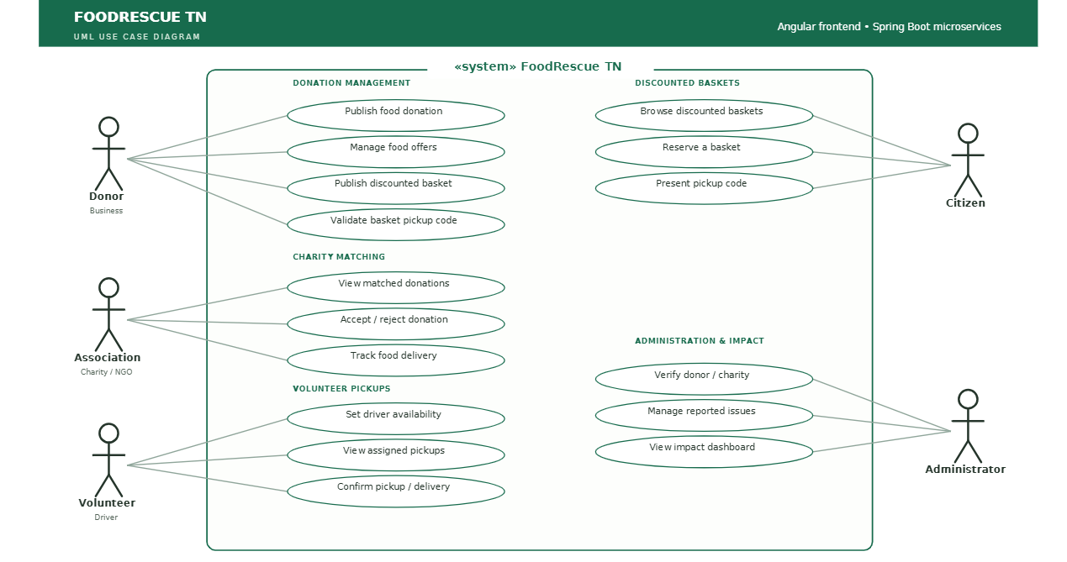
3 ·General Use case
FoodRescue TN · 5
FoodRescue TN · 7

Slide 8
4 · Architecture and security
Angular front end
responsive UI · Leaflet · Chart.js
API Gateway
routing · JWT check · CORS · rate limit
Keycloak
OAuth2 · JWT · 5 roles
Donation Offer
MongoDB
Matching & Pickup
PostgreSQL + PostGIS
Partner Trust
PostgreSQL
Volunteer Driver
PostgreSQL
Surprise Basket
PostgreSQL
Impact Analytics
PostgreSQL
RabbitMQ OfferPublished · MatchConfirmed · DeliveryCompleted · RatingSubmitted · BasketOrdered · BasketCollected
Eureka
discovery
Config Server
central config
User & Auth + Notification
shared, whole team
Docker Compose
one-command start
Security: Keycloak issues JWT · Gateway checks token and role (DONOR, ASSOCIATION, DRIVER, CITIZEN, ADMIN) · services reachable only through the gateway · no password in business services
FoodRescue TN · 8

Slide 9
5 · Microservices, responsibilities, databases
Service | Owner | Responsibility | Database
Donation Offer Service | Malek Hammami | Publish, edit, expire surplus offers | MongoDB
Matching & Pickup Service | Med Lotfi Sherif | Nearest-association match, pickup tracking | PostgreSQL + PostGIS
Partner Registry & Trust Service | Salma Boubakri | Profiles, verification, safety checklist, ratings | PostgreSQL
Impact Analytics Service | Yasmine Ben Abdelkader | kg → meals → CO₂e, dashboard, report | PostgreSQL
Volunteer Driver Service | Rayen Ghileb | Availability slots, driver assignment | PostgreSQL
Surprise Basket Service | Mohamed Fadhel | Discounted baskets, orders, pickup codes | PostgreSQL
User & Auth + Notification | Whole team | Accounts, roles, e-mail / push alerts | Keycloak + PostgreSQL
FoodRescue TN · AWD 4DASI2 · 5
FoodRescue TN · 9

Slide 10
6 · Communication between services
SYNCHRONOUS · REST + OpenFeign
ASYNCHRONOUS · RabbitMQ events
The caller waits for the answer
The producer never waits
Matching → Offer: lock the offer
Matching → Partner: capacity, location
Matching → Driver: free driver nearby
Offer → Partner: is the donor verified?
OfferPublished → Matching
MatchConfirmed → Notification
DeliveryCompleted, RatingSubmitted → Impact
BasketOrdered → Offer · BasketCollected → Impact
THE MAIN FLOW
Donor publishes
OfferPublished
→
Match confirmed
MatchConfirmed
→
Driver delivers
DeliveryCompleted
→
Impact updated
weight in kg · meals · CO₂e
FoodRescue TN · 10

Slide 11
7 · Technologies and task allocation
Back end
Java 17 · Spring Boot 3
WHO BUILDS WHAT
Malek Hammami · Donation Offer
Spring Cloud
Gateway · Eureka · Config · OpenFeign · Resilience4j
Med Sherif · Matching & Pickup
Security
Keycloak · OAuth2 / JWT
Salma Boubakri · Partner Registry & Trust
Messaging
RabbitMQ
Yasmine Ben Abdelkader · Impact Analytics
Data
PostgreSQL + PostGIS · MongoDB
Rayen Ghileb · Volunteer Driver
Front end
Angular · Leaflet · Chart.js
Mohamed Fadhel · Surprise Basket
DevOps
Docker Compose · GitHub Actions · Swagger
Shared: User & Auth + Notification, Gateway, Eureka, Config, RabbitMQ, docs, demo
Polyglot
Python FastAPI (demand forecast)
FoodRescue TN · 11

Slide 12
8 · Git organisation and schedule
Git repository
Project management
/Backend · /Frontend · /Documentation
Feature branch → pull request → review → main
GitHub Actions CI: build and tests on every push
Scrum: sprint planning, review, retrospective
Board: backlog → in progress → review → done
Tool: GitHub Projects
S0
S1
S2
S3
S4
S5
W1–2
Design
W3
Foundations
W4
Security + flow
W5
Events
W6
Trust + impact
W7
Release + demo
FoodRescue TN ·12

Slide 13
9 · Main risks and mitigation
Risk | Mitigation
Matching complexity | Start with a simple nearest-first rule, improve later
Keycloak configuration | One shared realm with the five roles, set up early
Integration drift | Contract-first REST and events, shared Postman collection, mocked events
Uneven workload | Weekly integration test and progress review
No real data | Seeded demo data, simulated payment, conversion factors from a cited source
FoodRescue TN · 13

Slide 14
10 · Donation Offer Service
Malek Hammami · MongoDB
CLASS DIAGRAM
INTERACTIONS
Offer
SYNC Offer → Partner: is the donor verified? · Matching → Offer: details + lock
ASYNC publishes OfferPublished · consumes BasketOrdered
donorId, title, category, estimatedWeightKg, availableQuantity, status
PickupWindow
API CONTRACT
start, end (1 offer – 1 window)
Verb | Endpoint | Codes
POST | /api/offers | 201 · 400 · 403
GET | /api/offers?category=&status= | 200
GET | /api/offers/{id} | 200 · 404
PUT | /api/offers/{id}/cancel | 200 · 404 · 409
Location
address, governorate, GeoJSON point
OfferStatus «enum»
AVAILABLE · LOCKED · COLLECTED · EXPIRED · CANCELLED
FoodRescue TN · 14

Slide 15
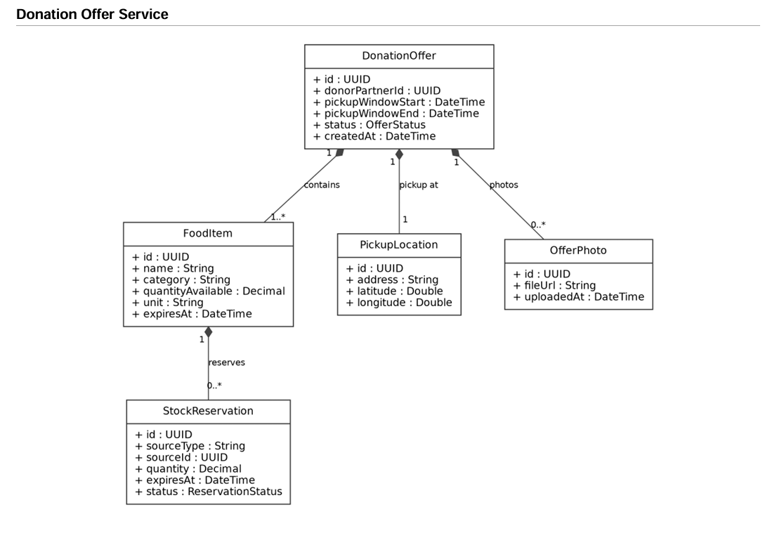
Notes:
1 minute, owner only.

Slide 16
11 · Matching & Pickup Service
Med Sherif · PostgreSQL + PostGIS
CLASS DIAGRAM
INTERACTIONS
Match
SYNC Matching → Offer (lock), Partner (capacity), Driver (nearby)
ASYNC consumes OfferPublished · publishes MatchConfirmed, DeliveryCompleted
offerId, associationId, distanceM, status
Pickup
API CONTRACT
matchId, driverId, window, quantityKg, status
Verb | Endpoint | Codes
POST | /api/matches | 201 · 404 · 409
PATCH | /api/pickups/{id}/status | 200 · 403 · 404
GET | /api/pickups?driverId= | 200
POST | /api/pickups/{id}/assign | 200 · 404 · 409
PickupStatusHistory
oldStatus, newStatus, changedBy, changedAt
PickupStatus «enum»
SCHEDULED → ASSIGNED → IN_TRANSIT → DELIVERED
FoodRescue TN · 16
Notes:
1 minute, owner only.

Slide 17
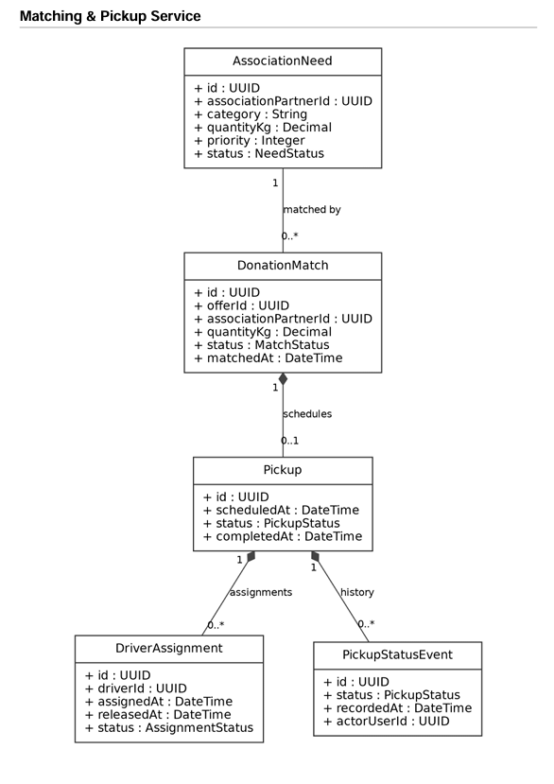
FoodRescue TN · 17
Notes:
1 minute, owner only.

Slide 18
12 · Partner Registry & Trust Service
Salma Boubakri · PostgreSQL
CLASS DIAGRAM
INTERACTIONS
Partner
SYNC Offer and Matching call Partner: verified? capacity, location
ASYNC publishes RatingSubmitted (consumed by Impact)
type, name, governorate, capacityKg, verificationStatus, trustScore
SafetyChecklist
API CONTRACT
pickupId, temperatureOk, packagingOk, expiryOk, hygieneOk
Verb | Endpoint | Codes
POST | /api/partners | 201 · 400
PUT | /api/partners/{id}/verify | 200 · 403 · 404
POST | /api/partners/{id}/ratings | 201 · 400
GET | /api/partners/{id} | 200 · 404
Rating
raterId, ratedId, pickupId, score (1–5), comment
AcceptedCategory
partnerId, category (associations only)
FoodRescue TN· 18
Notes:
1 minute, owner only.

Slide 19
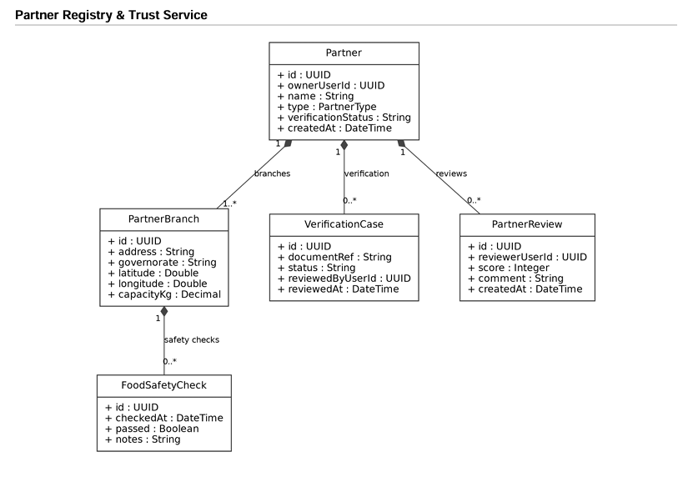
FoodRescue TN · 19
Notes:
1 minute, owner only.

Slide 20
13 · Impact Analytics Service
Yasmine Ben Abdelkader · PostgreSQL
CLASS DIAGRAM
INTERACTIONS
ImpactFact
SYNC Angular dashboard reads indicators through the Gateway
ASYNC consumes DeliveryCompleted, BasketCollected, RatingSubmitted (idempotent)
eventId, source, donorId, governorate, quantityKg, meals, co2eKg
ImpactMonthly
API CONTRACT
yearMonth, governorate, donorId, kgSaved, meals, co2eKg
Verb | Endpoint | Codes
GET | /api/impact/global | 200
GET | /api/impact/governorates/{id} | 200 · 404
GET | /api/impact/donors/{id} | 200 · 404
GET | /api/impact/leaderboard | 200
PartnerScore
partnerId, averageScore, ratingsCount
ConversionFactor
category, mealsPerKg, co2ePerKg
FoodRescue TN · 20
Notes:
1 minute, owner only.

Slide 21
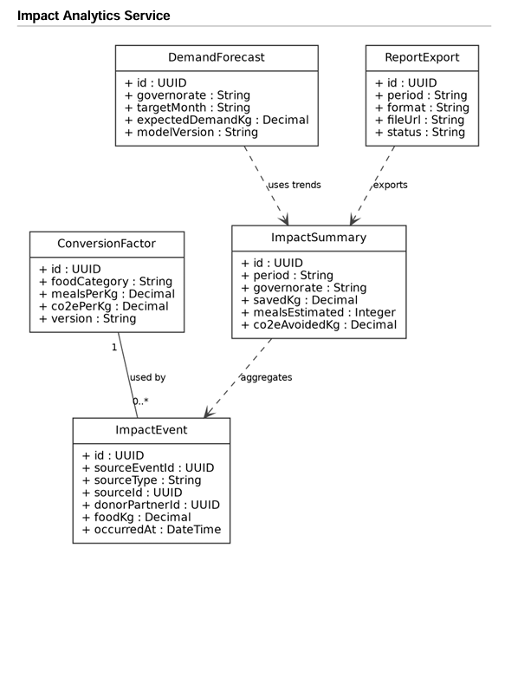
FoodRescue TN · 21
Notes:
Presented by one member.

Slide 22
14 · Volunteer Driver Service
Rayen Ghileb · PostgreSQL
CLASS DIAGRAM
INTERACTIONS
Driver
SYNC Matching → Driver: find a free driver near the pickup
ASYNC publishes DriverAssigned · consumes DeliveryCompleted
userId, vehicleType, capacityKg, governorate, active, averageRating
AvailabilitySlot
API CONTRACT
start, end, status (FREE / BOOKED) (1 driver – many slots)
Verb | Endpoint | Codes
POST | /api/drivers | 201 · 400
PUT | /api/drivers/{id}/availability | 200 · 404
GET | /api/drivers/available?lat=&lng= | 200
POST | /api/assignments/{id}/accept | 200 · 404 · 409
Assignment
driverId, slotId, pickupId, status
DriverRating
driverId, pickupId, score, comment
FoodRescue TN · 22

Slide 23
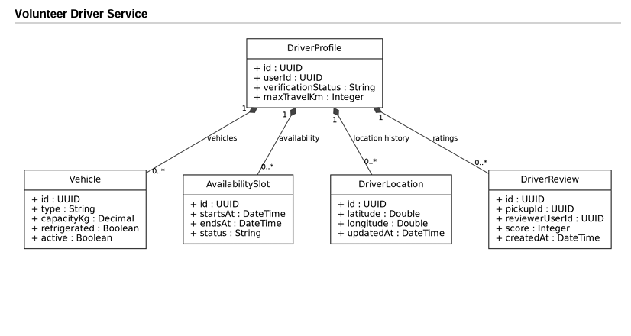
FoodRescue TN · 23

Slide 24
15 · Surprise Basket Marketplace Service
Mohamed Fadhel · PostgreSQL
CLASS DIAGRAM
INTERACTIONS
Basket
SYNC Marketplace → Offer: read stock details when building a basket
ASYNC publishes BasketOrdered, BasketCollected
donorId, offerId, title, discountedPrice, weightKg, quantityAvailable, status
BasketOrder
API CONTRACT
basketId, citizenId, quantity, pickupCode, paymentStatus, status
Verb | Endpoint | Codes
GET | /api/baskets?governorate= | 200
POST | /api/orders | 201 · 400 · 409
PUT | /api/orders/{id}/collect | 200 · 404 · 409
DELETE | /api/orders/{id} | 204 · 404
BasketStatus «enum»
PUBLISHED · SOLD_OUT · EXPIRED · CANCELLED
Payment
simulated in this project (no real payment)
FoodRescue TN · 24

Slide 25
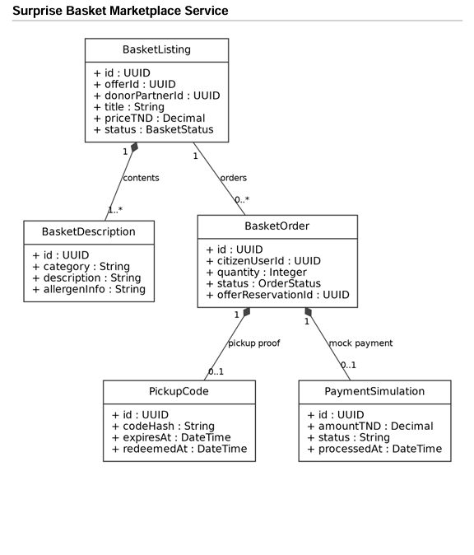
FoodRescue TN · 25

Slide 26
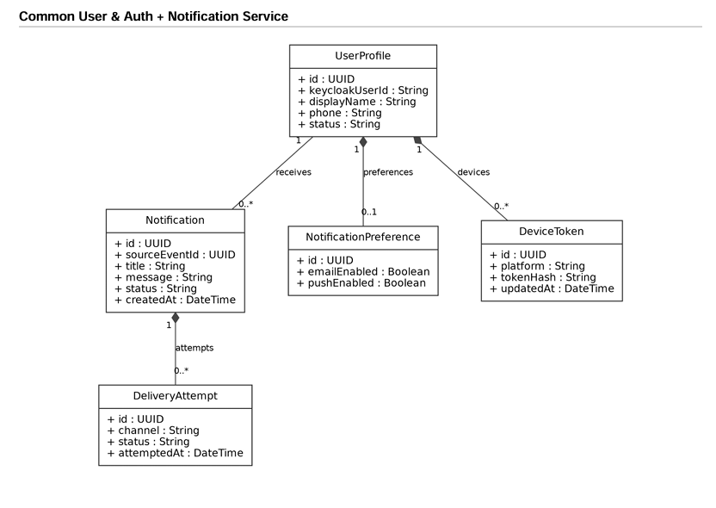
FoodRescue TN · 26

Slide 27
17· Functional and non-functional requirements
FUNCTIONAL · 22 REQUIREMENTS
NON-FUNCTIONAL
01
02
03
Security
Identity & trust
Donation offers
Matching & pickup
Keycloak OAuth2 / OIDC, JWT checked at the Gateway, role-based access on every endpoint
Role-based sign-up, partner profiles, admin verification, food-safety checklist, ratings
Publish, edit or cancel surplus; automatic expiry at the end of the pickup window
Nearest-association matching, match confirmation, pickup tracking to delivery
Availability
One service failing never blocks the main flow: timeouts, retries, circuit breaker (Resilience4j)
Scalability
04
05
06
Each service scales independently, discovered through Eureka
Volunteer drivers
Surprise baskets
Impact & notifications
Loose coupling
Availability slots and automatic assignment of a nearby driver
Discounted baskets, simulated payment, unique pickup code
kg saved, meals, CO₂e; dashboard per governorate and donor; monthly report; e-mail / push alerts
Database per service, facts exchanged as RabbitMQ events
Performance
Optional: demand forecast (FastAPI)
Geospatial indexes for matching, pre-computed aggregates for dashboards
22 functional requirements · 5 actors · 6 microservices · traceable status history on every pickup and order
FoodRescue TN · 27

Slide 28
CONCLUSION
From surplus to someone's table.
FoodRescue TN connects donors, associations, drivers and citizens in one traceable, measurable platform, and turns food waste into solidarity.
6
microservices
01
02
03
04
5
actors
Publish
Match
Deliver
Measure
22
requirements
Donor posts surplus
Nearest association
Volunteer driver, tracked
kg · meals · CO₂e
Built to scale
Built to trust
Built to hold
Six independent services, each with its own database, discovered through Eureka.
Keycloak and JWT at the gateway, verified partners, safety checklists and ratings.
Events with RabbitMQ and Resilience4j: one service down never blocks the main flow.
Thank you! Ready For Your Questions!
Malek Hammami · Med Sherif · Salma Boubakri · Yasmine Ben Abdelkader · Rayen Ghileb · Mohamed Fadhel
FoodRescue TN · 28

